Slide 1
Hotel Booking Model
Norman Cattles

Slide 2
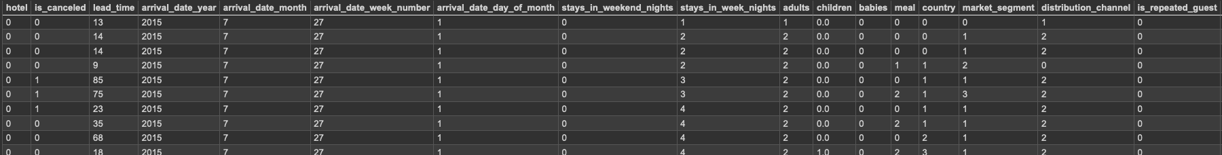
Recap
Hotel Booking Demand
This dataset comprises detailed records of over 100,00 hotel bookings, including various details such as hotel type, hotel country, booking date, arrival date, length of stay, and much more

Slide 3
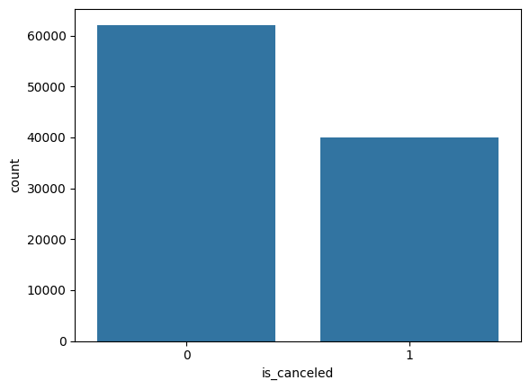
Model Selection?
0 (not cancelled), 1 (cancelled)
I want to develop a model that can guess whether or not a hotel reservation has been cancelled or not
Binary classification problem
K- Nearest Neighbors Algorithm
Intuitive
Easy to Implement
Reliable results

Slide 4
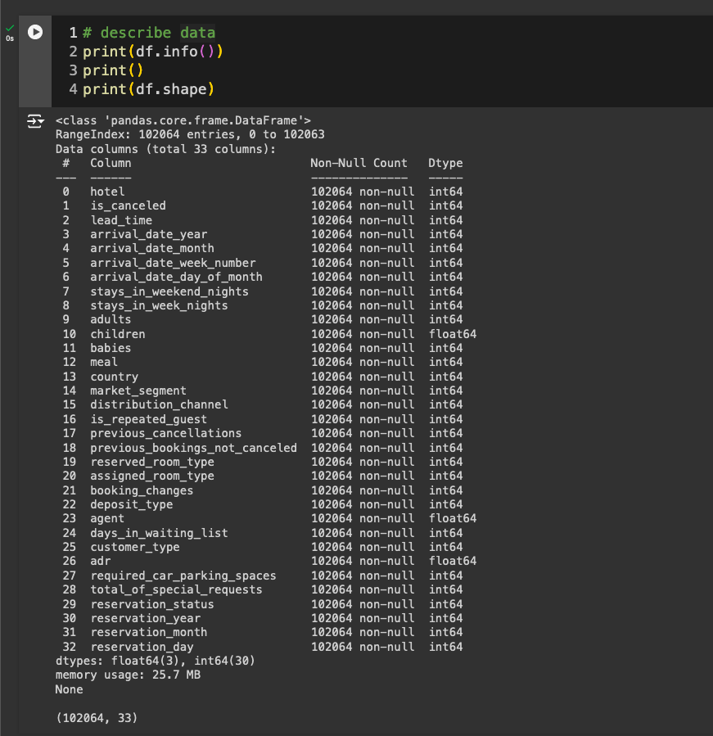
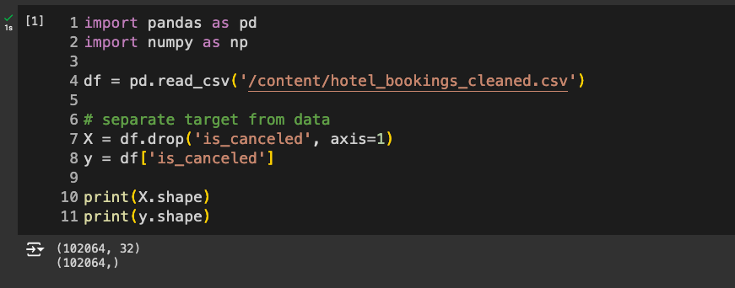
Dataset

Slide 5
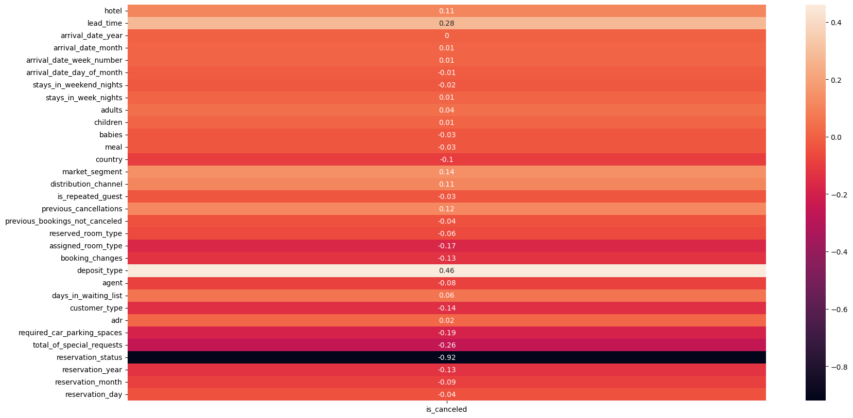
Data Insights
Heatmap
Used to understand positive and negative correlations between features
can provide basic insight into distribution of features and cancelled reservations
lead_time
deposit_type
reservation_status

Slide 6
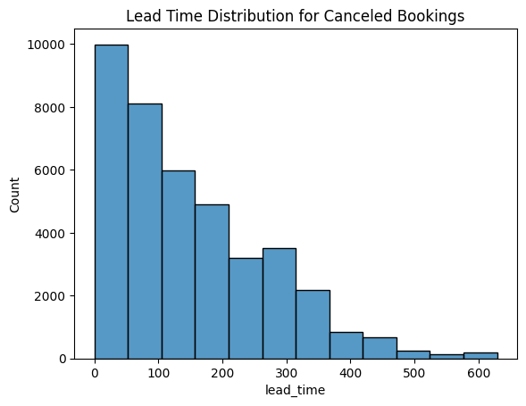
Data Insights
We care about cancelled bookings
lead_time is the numbers of days before reservation date a booking is made
~ 18,000 (~20%) of bookings that were cancelled had a lead time of 3 months or less
In other words, bookings with a lead time of 3 months or less were more likely to get cancelled as opposed to bookings with lead times of more than 3 months

Slide 7
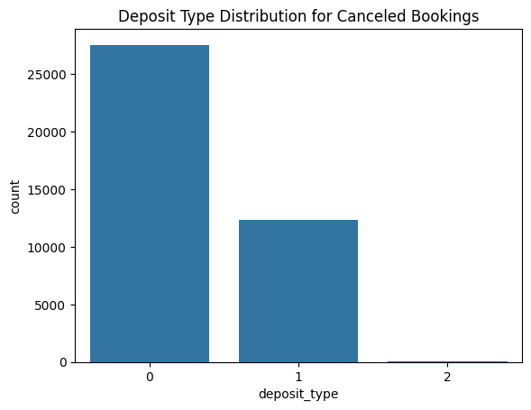
Data Insights
Deposit Type
No Deposit : 0
Non Refund : 1
Refundable : 2
~30,000 (~30%) of cancelled bookings had a deposit type of no deposit
No deposit reservations were MUCH more likely to be cancelled as opposed to other deposit types

Slide 8
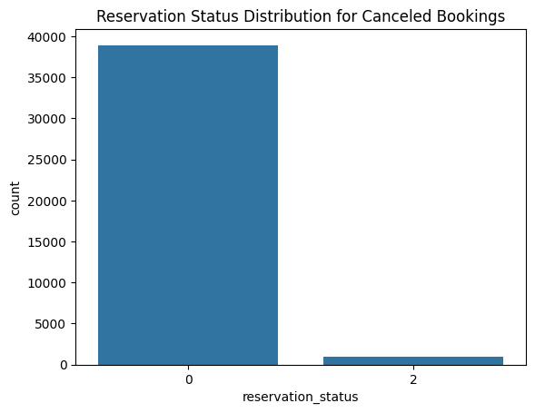
Data Insights
Reservation Status
Cancelled: 0
No-Show: 2
~40,000 of cancelled bookings had a reservation status of cancelled
This doesn’t tell us much, but it does explain why there was such a strong negative correlation between reservation_status and is_cancelled in our heatmap
-0.92
Technically, the lower the value of reservation_status (0), the higher the value of is_cancelled (1)

Slide 9
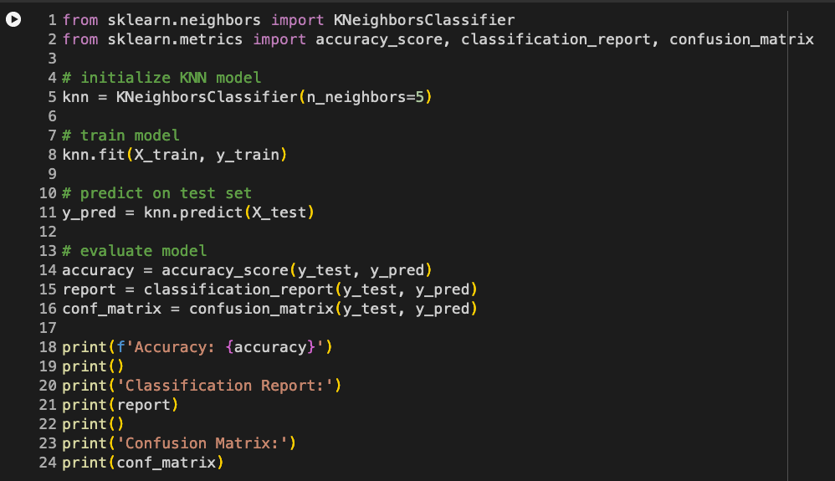
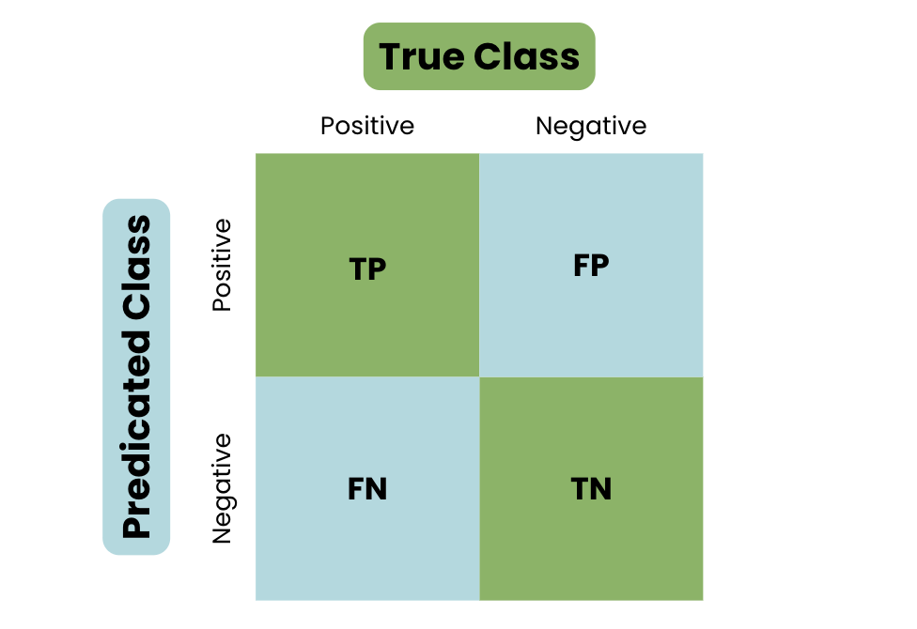
K-Nearest Neighbor Implementation
Accuracy
correct predictions / total # of predictions
Precision
true positive predictions / total # positive predictions
accuracy of positive predictions
Recall
true positive predictions / total # of actual positives
F1-Score
mean of precision and recall
Confusion Matrix

Slide 10
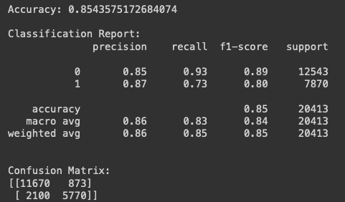
K-Nearest Neighbor Implementation
Accuracy
correct predictions / total # of predictions
Precision
true positive predictions / total # positive predictions (TP + FP)
accuracy of positive predictions
Recall
true positive predictions / total # of actual positives (TP + FN)
ability to correctly categorize
F1-Score
mean of precision and recall
Confusion Matrix

Slide 11
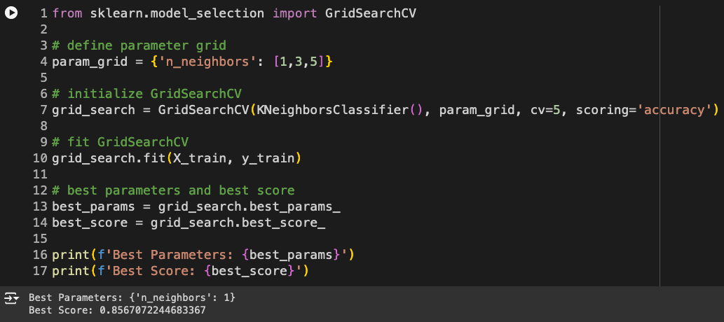
Hyperparameter Tuning
GridSearchCV
works through multiple combinations of parameter values, cross-validates each combination, and selects the set of parameters that produces the best performance for the model
neighbors tested
1, 3, 5
5-fold cross validation was performed for each iteration of neighbor
Using 1 neighbor returned the best results
produced an accuracy of 85.7%, which is slightly better than 5 neighbors returning 85.4%

Slide 12
Conclusion
Challenges faced
I tried testing my knn algorithm for with more neighbors - for example, selecting a range from 1-10 of neighbors in my hyperparameter tuning - but testing this model with this number takes such a ridiculous amount of time
Forced to use small amount of parameters
How to apply results
If a booking is predicted to be cancelled, companies could allocate resources to other areas
revenue management
For predicted cancellations, companies could provide customers with special offers/upgrades to reduce the chance of that cancellation
Since non refundable deposit types led to less cancellations, promote this option more

Slide 13
Thank you

